Slide 1
Who is your favorite actor?

Slide 2
Conversations on Acting
Take 30 seconds and think of your favorite actor
Got it? Good
On your paper, please write their favorite actor

Slide 3
Conversations on Acting
Now think about why you love their acting.
Write at least three things about the actor you like about their acting
Write at least 3 of their films/shows/plays/performances you like best

Slide 4
Favorite actor power point
Assignment:
Create a 3 slide Power point on your favorite actor.
Slide 1: Title card. Must include: your name, period, date, title of the assignment and the name of your actor
Slide 2: The name and headshot of your favorite actor and why you like them.
Slides 3: At least 3 pics of your actor in your favorite film roles and an explanation of why you like that performance/character.
Email to rachel.hibler@therhsriders.com
Label email: period/your name/favorite actor

Slide 5
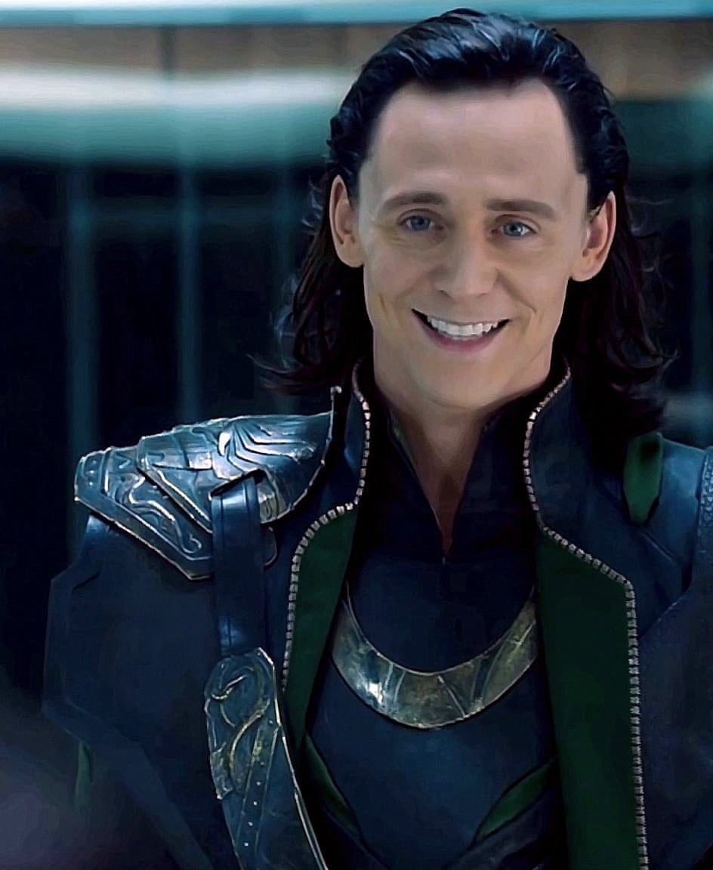
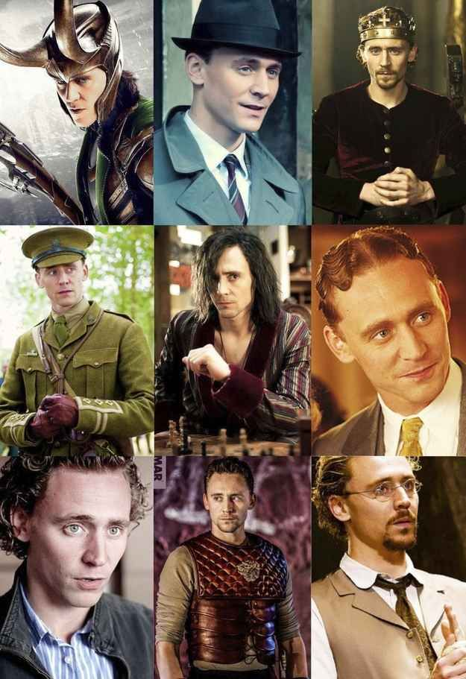
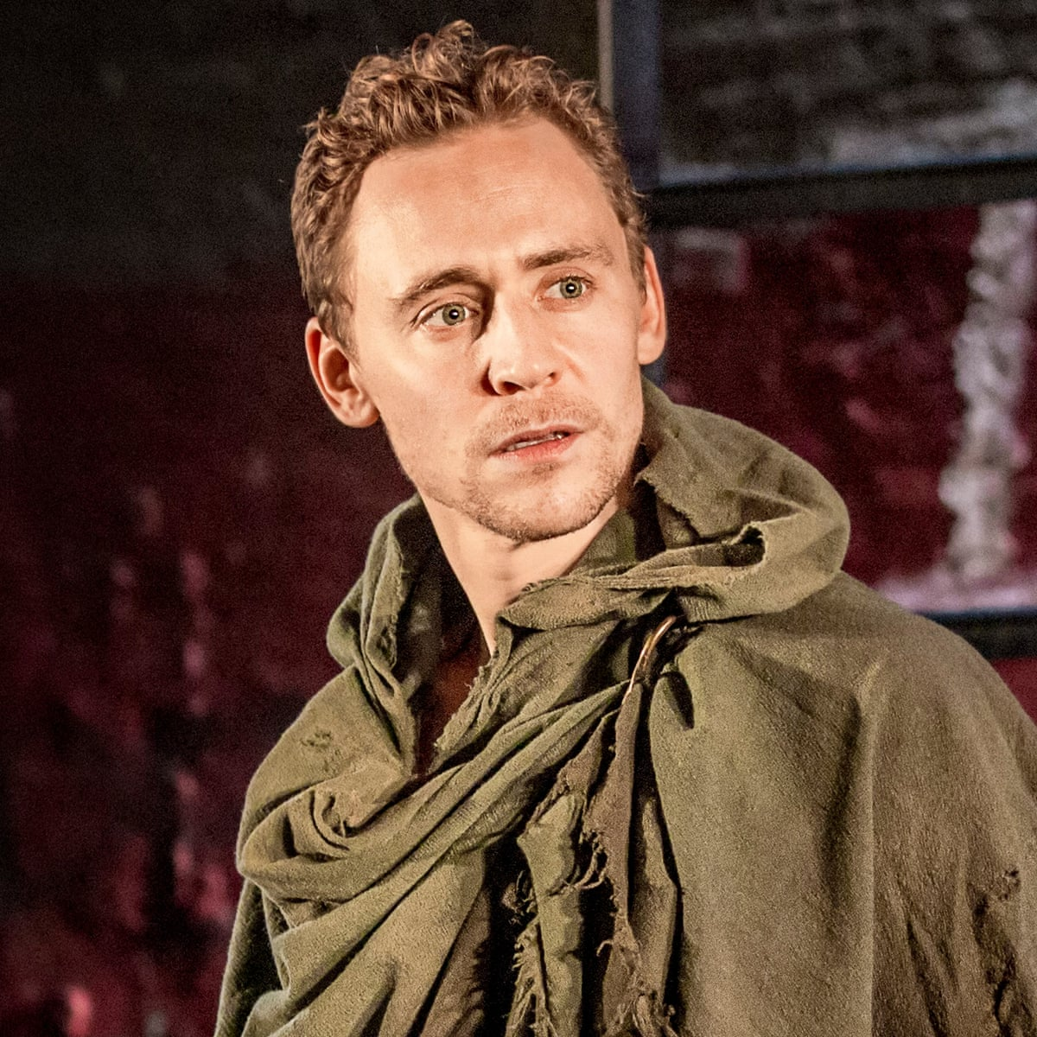
Favorite Actor Assignment
Slide 1 Example
Rachel Hibler
Period 1
8/20/2022
Tom Hiddleston

Slide 6
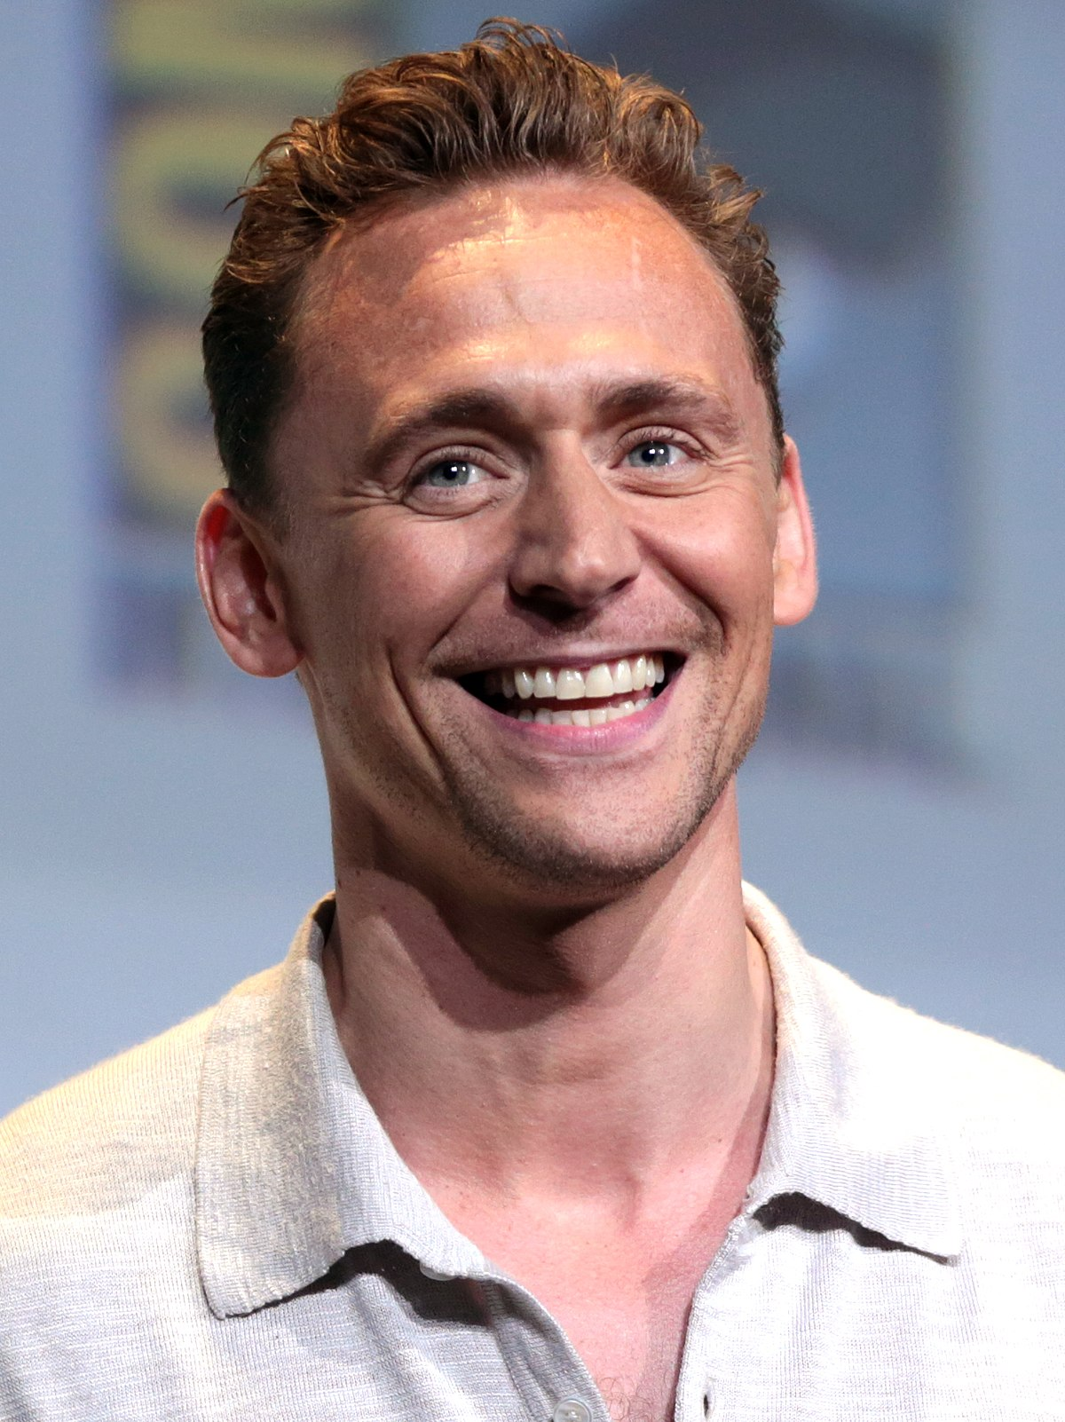
Slide 2 Example
Tom hiddleston
the reason I love tom Hiddleston’s acting is because he is classically trained on the stage and in Shakespeare and has translated that background into film acting. He can handle serious roles as well as funny parts. He has a good sense of humor and seems to enjoy acting.

Slide 7
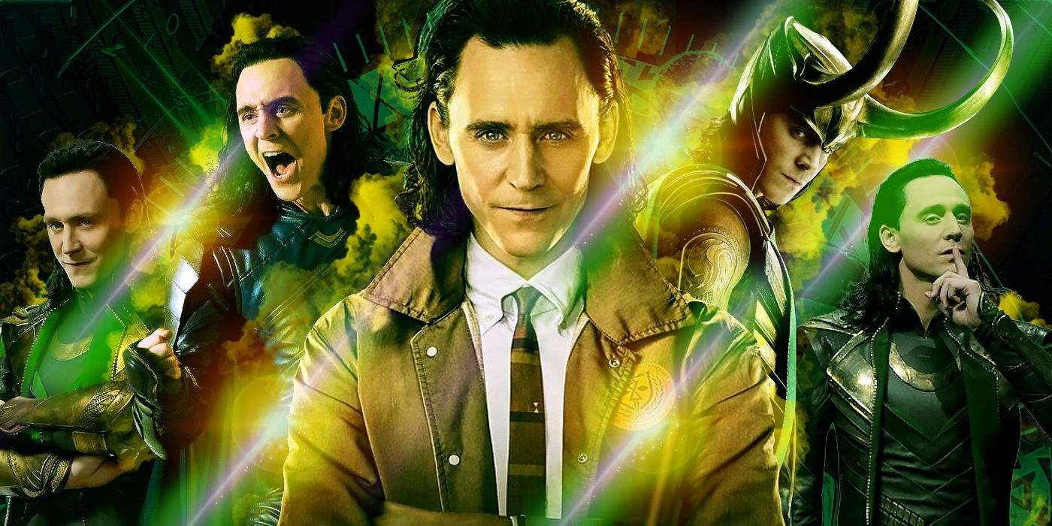
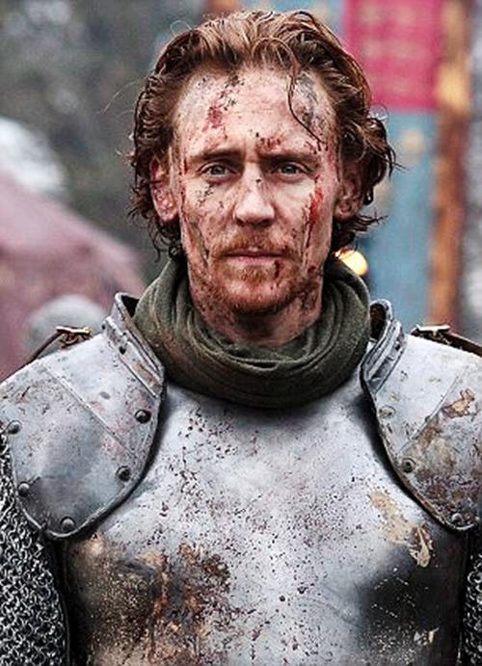
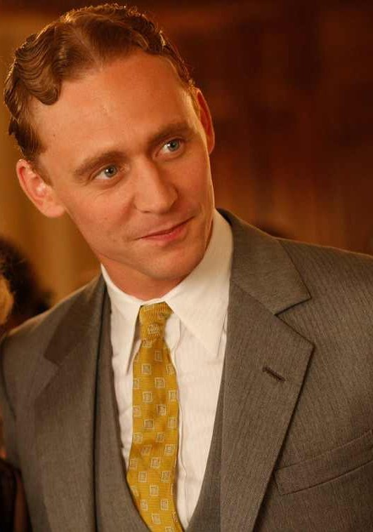
Slide 3 Example
Henry V
Tom goes back to his stage roots as henry v in Shakespeare’s history play of the same name. he is vulnerable and powerful in this part. He exudes kingship while also admitting his faults as he plays one of history’s most famous kings.
loki
Probably Tom Hiddleston’s best known character is Loki from the Marvel universe. I love his performance as this character because he is constantly changing and growing as a character. Tom doesn’t keep the character the same from film to film, he keeps things fresh and exciting. That is true acting, getting to know a character so well that you can explore their full journey.
F. Scott Fitzgerald
Tom plays the legendary writer in “midnight in paris”. He is fun, cheeky and irreverent. You can tell he’s having an absolute ball as this playboy. He only has about 15 minutes of screen time, but I think he steals the film.

